Slide 1
Predictive Modeling of Police Traffic Stops in San Francisco
By Joan Sandeep Larson M (2448027)

Slide 2
Project Motivation & Objectives
Importance of analyzing police stops for transparency, fairness, and public safety
Goals:
Predict arrest likelihood after stops
Compare performance of different ML models
Extract insights from demographic and behavioral features

Slide 3
Dataset Description
Source: Stanford Open Policing Project – San Francisco traffic stops (approx. 900k records)
Time span: 2007 to mid-2016
Key features:
subject_age, subject_race, subject_sex, district
reason_for_stop, search_conducted, arrest_made (target)
Data quality: missing values imputed, categorical variables encoded

Slide 4
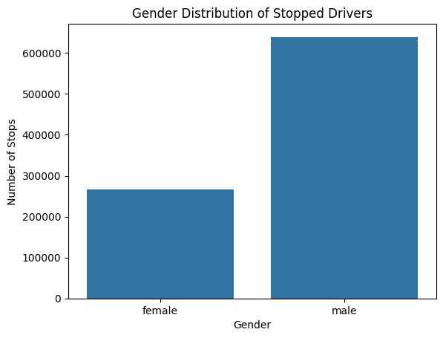
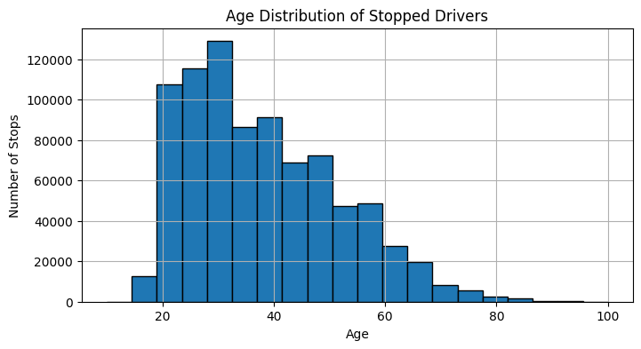
Exploratory Data Analysis (EDA) - Demographics
Distribution by gender: ~70% male, ~30% female
Age distribution centered mostly 20-40 years
Race categories and stop frequency displayed (bar chart)
Insights on social and demographic coverage

Slide 5
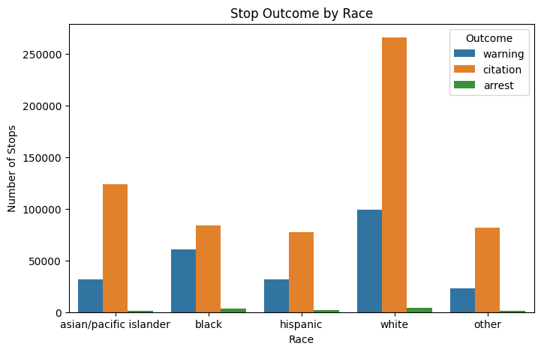
EDA - Stop Outcomes and Disparities
Arrests less common (~5%)
Searches conducted rarely (~6%)
Contraband found infrequently (<1%)
Search and contraband rates differ by race:
High search rates among Black drivers
(15.5%) vs. White (3.1%)
Contraband more often found in White
stops compared to Black
Visualizations: bar plots for search
& contraband rates by race

Slide 6
Data Preprocessing & Feature Engineering
Handling missing data with median and ‘Unknown’ values
Label encoding of categorical variables
StandardScaler applied to subject_age for MLP
Addressing class imbalance:
XGBoost with scale_pos_weight
TabNet with RandomOverSampler
MLP with class weights in loss function
Search conducted rate: (proportion of all stops where search was done) 0.0590 (5.90%)
Contraband found rate: (proportion of all stops where contraband was found) 0.149 (14.94%)

Slide 7
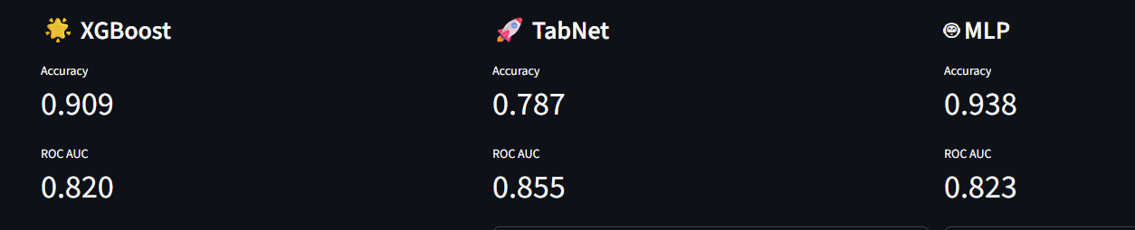
Modeling Approach
XGBoost: Efficient gadient boosting tree classifier
TabNet: Deep learning for tabular data with categorical feature support
MLP (Keras): Neural network with scaling and class weighting
Training details and hyperparameters (epochs, patience, batch size)
Logging and saving best models and scalers

Slide 8
Model Evaluation Results
Metrics: Accuracy, ROC AUC
Tabular and bar chart comparison of all models
Challenges and Solutions
Class imbalance handled by oversampling and class weighting
Categorical encoding consistency critical for avoiding TabNet CUDA errors
Hardware issues: CUDA troubleshooting and fallback to CPU
Importance of rigorous preprocessing pipeline for reproducibility

Slide 9
Conclusions & Future Work
TabNet showed strongest overall performance
Insights into policing patterns and demographic disparities found
Next steps:
Fairness and bias assessment
Expanded feature sets and temporal modeling
Deployment considerations for real-time risk assessment tools

